Slide 1
CMSC 449 Malware Analysis
Lecture 16
Anti-Disassembly

Slide 2
Anti-Analysis Review
Malware authors don’t want you to understand how their malware works
We’ve discussed other anti-analysis techniques such as:
Obfuscating strings
Packing
Runtime linking
Anti-VM and Anti-sandbox checks
Anti-debugging timing checks

Slide 3
Anti-Disassembly
Disassembling an executable file is not an easy task
Need to tell the difference between code and data
Need to know boundaries between opcodes
Anti-disassembly – Adding specially crafted code to a program which can cause a disassembler to produce incorrect or misleading results

Slide 4
Linear Disassembly
Simplest disassembly method
Assumes everything is instructions packed neatly together
Disassemble the instruction at the entry point
Use the size of the disassembled instruction to figure out where to start disassembling next
Mostly works fine, but can produce errors even on non-malicious binaries

Slide 5
Flow-Oriented Disassembly
Method used by IDA Pro and other commercial disassemblers
Examines each instruction and builds a list of locations that need to be disassembled
Disassemble instructions linearly until a branching instruction is found (e.g. a jump or call)
Continue disassembling the next instructions after the branch
But also add the branching destination to a list of locations to disassemble later

Slide 6
Jump Instructions With the Same Target
Place two conditional jumps back-to-back
Which have opposite conditions and which jump to the same location
The jump will always be taken!
The disassembler doesn’t know this, and will continue disassembling after the second jump
Source: PMA Chapter 15

Slide 7
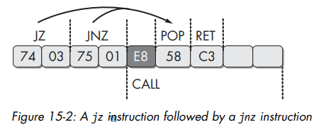
Jump Instructions With the Same Target
Source: PMA Chapter 15

Slide 8
Jump Instructions With the Same Target
Source: PMA Chapter 15

Slide 9
Jump Instructions with a Constant Condition
Use a conditional jump where the jump isn’t actually conditional
Again, the disassembler processes the negative branch first
Ambiguity about the E9 byte below (should really be data, not code)
Source: PMA Chapter 15

Slide 10
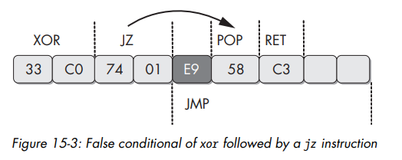
Jump Instructions with a Constant Condition
Source: PMA Chapter 15

Slide 11
Jump Instructions with a Constant Condition
Source: PMA Chapter 15

Slide 12
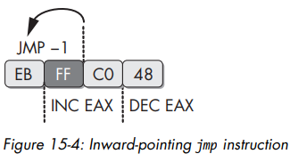
Impossible Disassembly
Cases where it’s impossible to “fix” a disassembly view
Bytes may be part of two different instructions at the same time
Source: PMA Chapter 15

Slide 13
More Complex “Impossible Disassembly”
This example has bytes that are part of multiple instructions, and a byte that is data
Source: PMA Chapter 15

Slide 14
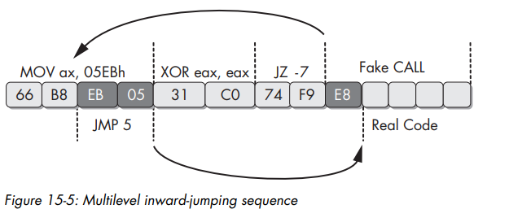
More Complex “Impossible Disassembly”
Source: PMA Chapter 15

Slide 15
Obscuring Flow Control
Flow-control disassemblers need to know branching destinations if a jump or call is made
Programs don’t necessarily need to compute these destinations until runtime
Many techniques for obscuring destinations of jumps and calls
Can also abuse the RET instruction, which is another way to branch
Source: PMA Chapter 15

Slide 16
CALL in Assembly Language - Review
What does CALL actually do?
CALL myFunc
PUSH &nextInstruction
SUB ESP, 4
MOV [ESP], &nextInstruction
JMP myFunc
Push the address in memory you’ll want to return to (i.e., where the next instruction is stored)
Have EIP jump to where the function you’re calling resides in memory

Slide 17
RET in Assembly Language - Review
What does RET actually do?
RET
POP EIP
Trusting that whatever’s at the top of the stack is the return address
Pop the return address we previously stored back into EIP

Slide 18
Abusing the RET Instruction
Can be used as a sneaky way to branch to other locations
Doesn’t need to be used to end a function
Push some address onto the stack, then call RET
This is equivalent to jumping to that address

Slide 19
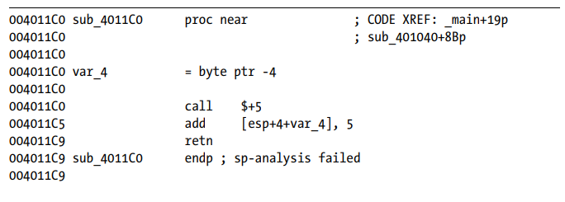
Abusing the RET Instruction
Source: PMA Chapter 15

Slide 20
Anti-Disassembly Example
Lab 15-01.exe

